Slide 1






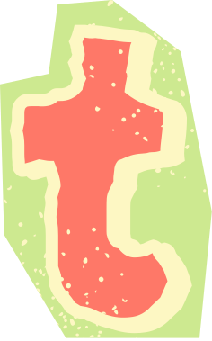











Slide 2




Introduce the teammate
Nurin Hazwani Binti Hussin
Wardina Safiah
Binti Harun
Nur Elisa Afira
Binti Mohd Nazir
A24CS0171
A24CS0209
A24CS0160

Slide 3



Problem Statement
Based on our research and survey, people face many challenges in meal planning and grocery management, especially students and housewives. They find that meal planning is stressful due to a tight budget and lack of time to prepare it. The need for a solution that offers personalized meal plans that take less time to prepare and budget-friendly options is the key to alleviating this stress.

Slide 4

Problem Statement
Budgetary constraints are another significant concern due to inflation. Most people find it hard to stick to a budget while shopping, leading to financial strain and inadequate meal planning. Therefore, a solution that integrates budget-friendly meal options along with grocery lists and store locations can increase efficiency.
Furthermore, accurate portion control and calorie tracking are important to maintain a healthy lifestyle. Most people struggle to diet due to overconsumption or excessive calorie intake. There are also others who suffer from nutrient deficiency because they think eating less food is equal to less calorie intake. Hence, a tool that can guide users on appropriate portion size and calorie intake would make their lives better.

Slide 5
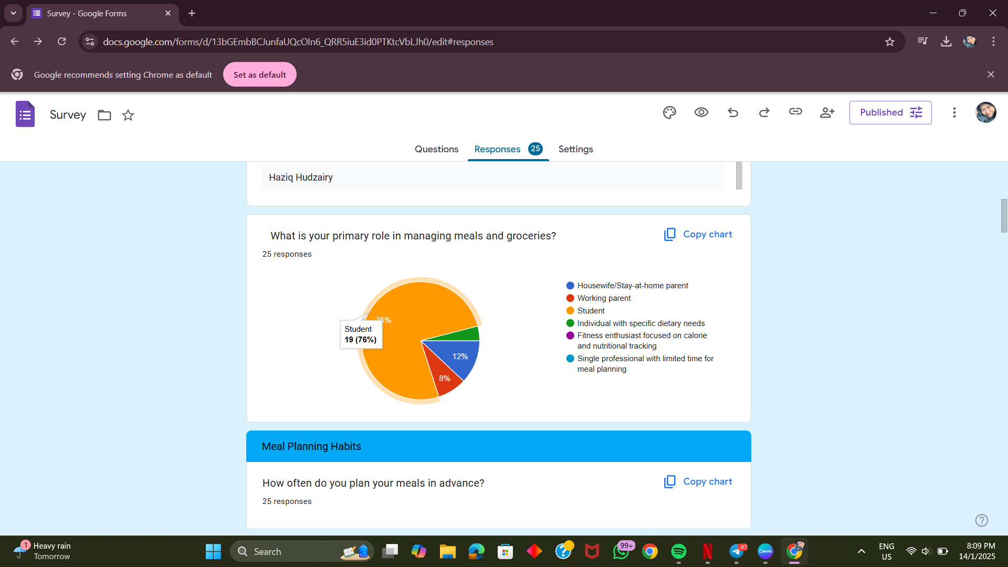

Survey overview
We make online survey through platform ‘Google Form’ to overview the needs of people like housewives, student, dietary person and others.
Majority respondent of survey that we made is student and the others is housewives (12%), working parents (8%), individual with specific dietary needs (4%)

Slide 6
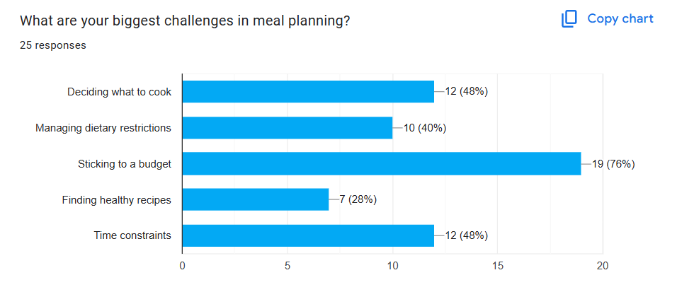
Survey overview
“What are your biggest challenges in meal planning?”.

Slide 7
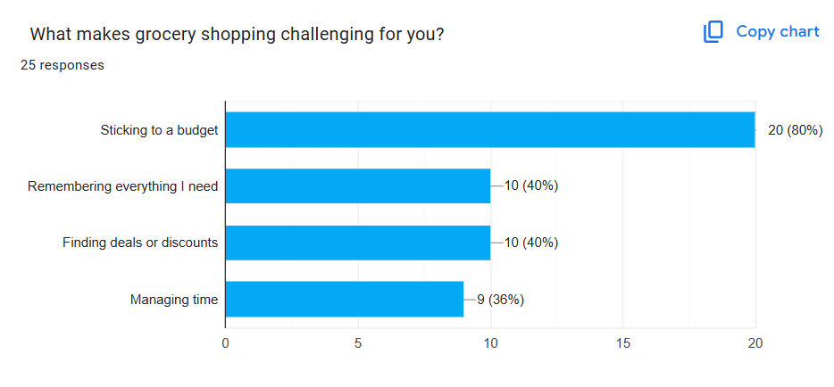
Survey overview
“What makes grocery shopping challenging for you?”.

Slide 8



OUR TARGETED PEOPLE
Working
parent
Housewife/
Stay-at-home parent
Individual with specific dietary needs

Slide 9

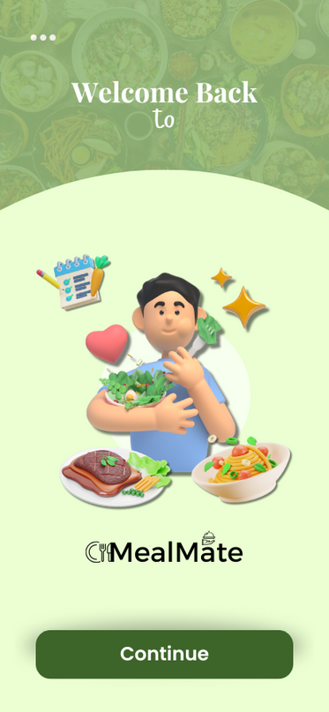

Discover Our Mealmate App
Meal Planning Made Easy
Convenient Features
Personalized Experience
Healthy Lifestyle Support

Slide 10

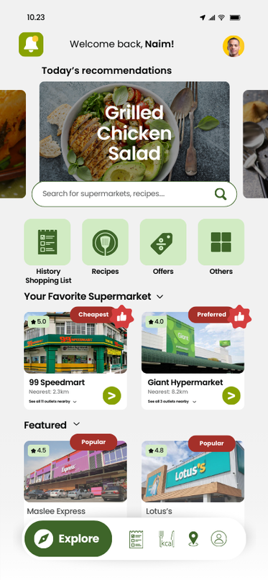
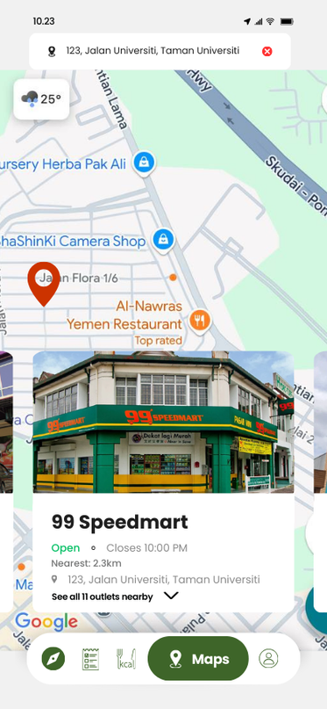
Discover Our Mealmate App
The mainframe integrates features like locating the nearest supermarket, tracking shopping history, offering personalized recipes, highlighting deals, and more for a seamless grocery and meal-planning experience.
This frame shows the nearest supermarkets, complete with addresses, distance, real-time availability, and closing times. Simply click on a supermarket to open it directly in your preferred map app for quick navigation, ensuring you never miss out on your shopping needs!

Slide 11
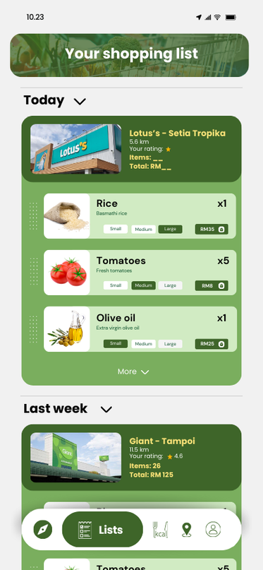
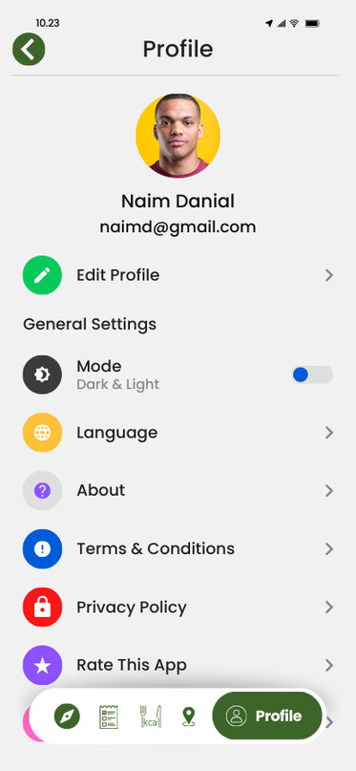
Discover Our Mealmate App
This frame showcases a customizable shopping list that you can personalize with your creativity and explore a variety of features we offer.
This frame features a ‘Profile’ section where customers can edit their personal details, select a preferred language, access app information, review terms and conditions, and explore many more options!

Slide 12
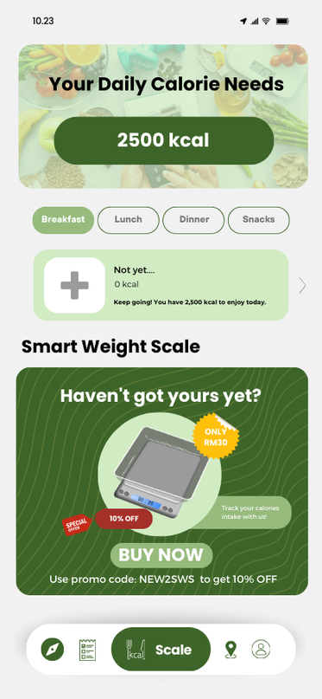
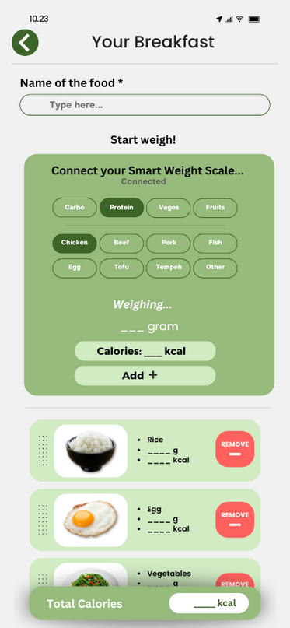
Discover Our Mealmate App
Revolutionize your fitness journey with our state-of-the-art ‘Daily Calories’ tracker, seamlessly connected to a wireless smart weight scale that provides real-time insights—available now for an incredible RM 30!
In this section, you can connect with our ‘Smart Weight Scale’ to weigh your food, automatically calculating and dividing the calories into categories such as protein, carbohydrates, and more for precise nutrition tracking.

Slide 13
Discover Our Mealmate App
MealMate features a wide variety of recipes to suit every taste and preference. Whether you're in the mood for chicken, fish, vegetarian options, or something more specific, you can easily find recipes that match your cravings. MealMate ensures there’s something for everyone, whether you're a seasoned cook or just starting your culinary journey!

Slide 14
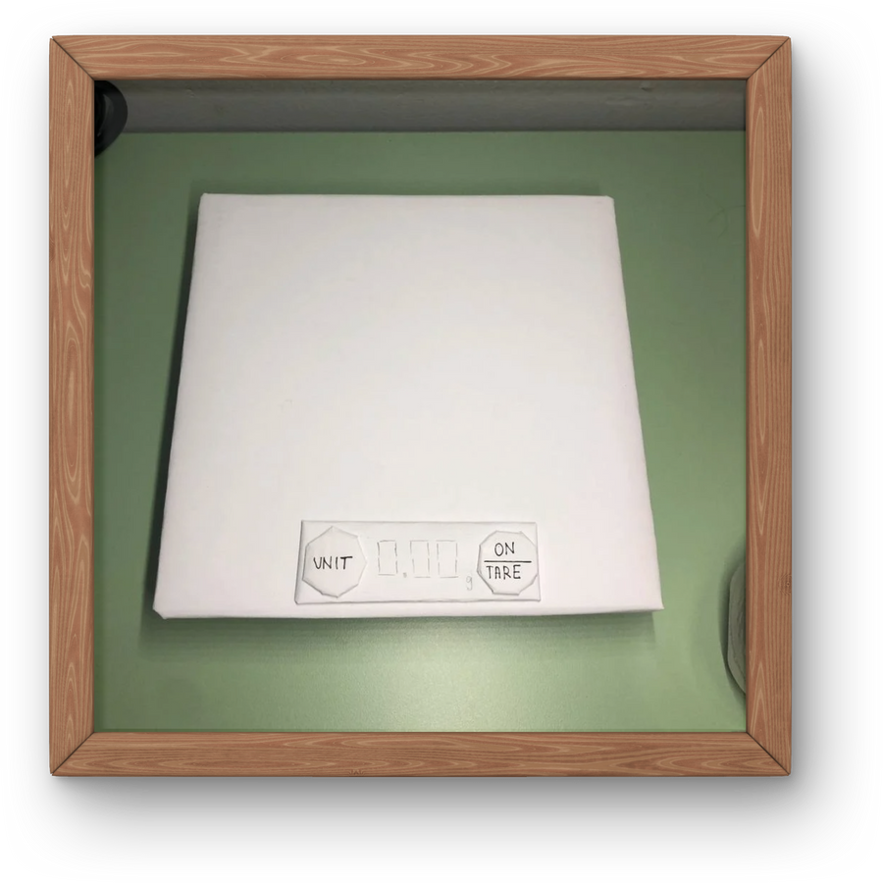
SMART WEIGHT SCALE
The Smart Weight Scale is an innovative device designed to measure and track the weight of food with precision. Perfect for cooking, meal prepping, or portion control, this intelligent scale makes managing your nutrition smarter and easier than ever. Whether you're a chef or someone striving for a healthier lifestyle, this modern gadget is your ultimate kitchen companion.

Slide 15
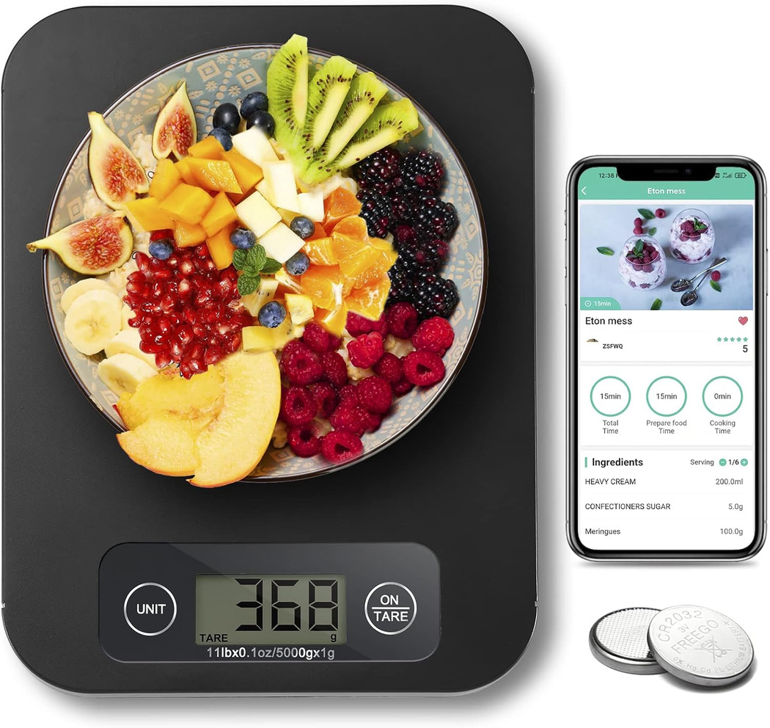

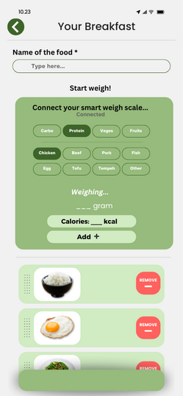
SMART WEIGHT SCALE
The ‘Smart Weight Scale’ is a wireless device that seamlessly connects to our app, enabling precise measurement of food portions and automatic calorie tracking. By weighing your ingredients, the scale sends real-time data to the app via Bluetooth. This allows the app to calculate the exact calorie intake and provide detailed nutritional information, helping you maintain a balanced diet effortlessly. Its integration ensures accurate portion control, making meal planning and healthy eating more convenient and efficient.

Slide 16








TIME-SAVING
CONVENIENT INTEGRATION
Streamlines meal planning and shopping with AI-generated grocery lists and recipes.
Helps locate the nearest supermarkets and provides navigation for seamless shopping.
PERSONALIZED OPTIONS
ORGANIZED SHOPPING
BENEFITS
Offers meal plans tailored to dietary preferences, family size, and health goals. It also comes with ‘Smart Weight Scale’ that can track your calories.
OF MEALMATE APP
Simplifies grocery trips with categorized shopping lists and store recommendations.
BUDGET-FRIENDLY
Helps manage costs with affordable meal suggestions and budget tracking.

Slide 17










